Slide 1

Digital Travel System Using Card Payment
BATCH MEMBERS
A.SATHAM HUSSAIN (812420104082)
E.VENKATESHWARAN (812420104097)
A.YASAR ARABATH (812420104099)
J.YUVARAJ (812420104100)
GUIDED BY
M.MOHAMED FAIZAL M.E.,
ASSISTANT PROFESSOR

Slide 2
OBJECTIVE
To create a centralized card for all modes of transportation.

Slide 3
INTRODUCTION
It is based on web application.
In this system that the passengers can buy ticket by scanning the card in public transports.
Passengers can recharge the card for transaction.

Slide 4
SOFTWARE COMPONENTS
Front end:
Html
CSS
Bootstrap
Back end:
Firebase
Mysql
HARDWARE COMPONENTS
Card Scanner
Digital card

Slide 5
Project Description
Digitalize public bus transportation system.
Interactive transport application:
Bus details,Transaction details,Travel Details.
Card balance/validity,Card verification and deactivation.
Also used for data analysis.

Slide 6
Modules Description
Admin
Passengers
Checkstatus

Slide 7
Admin Modules
Registration of card.
Check the card validation,Card balance.
Monitoring the passenger’s data.
To secure the passenger’s data.
To check the transaction details.

Slide 8
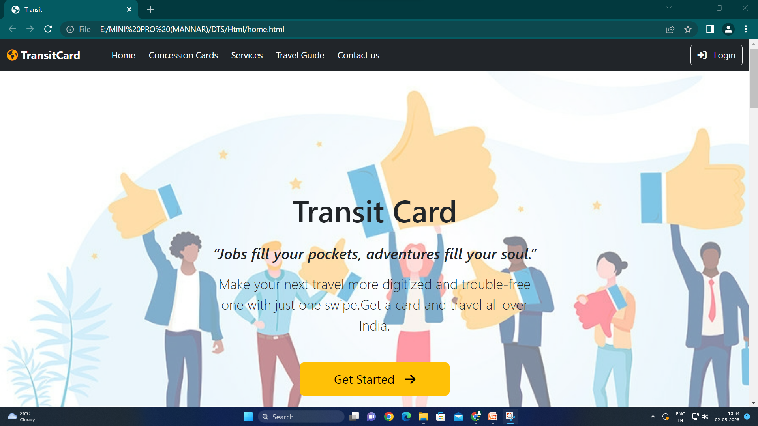

Slide 9
Passengers Modules
Passengers should choose the place,then they can buy the ticket by scaning the card.
Get amount for tickets through the card from passengers.

Slide 10
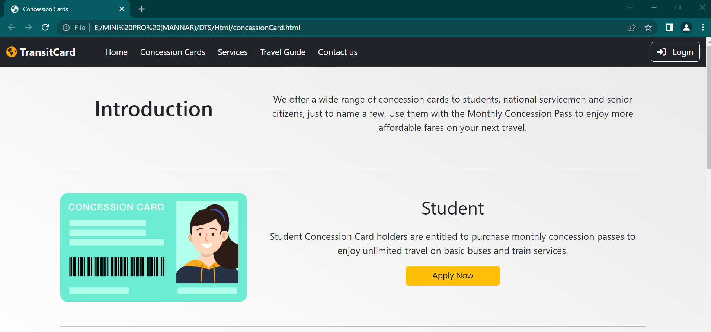

Slide 11
Checkstatus Module
Passengers can check the status of your application and can edit or cancel the application anytime.
User can replace and claim your card at any time.

Slide 12
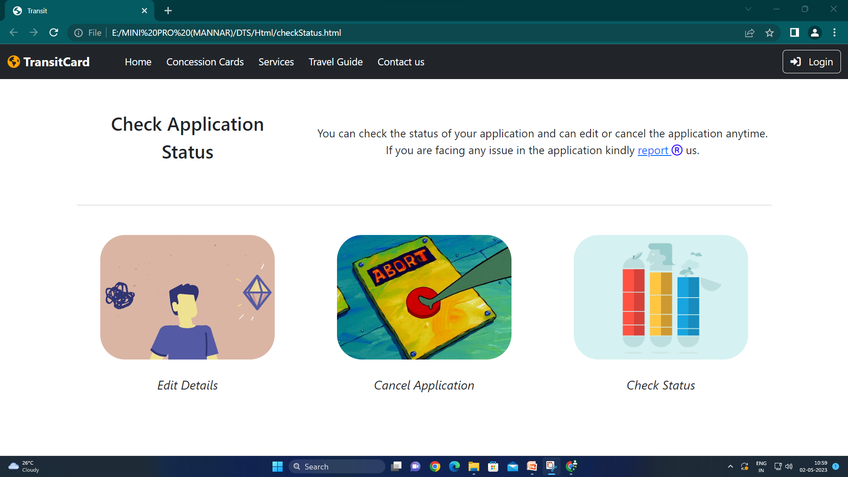

Slide 13
CONCLUSION
This system has been mainly focused to change the transportation ticket system through digital card system.
It has been developed fully responsive which can be used in Scanner has been installed in every public transportation.

Slide 14
THANK YOU

